Slide 1
19 CS 2109
COMPUTER NETWORKS AND SECURITY

Slide 2
Error Control
Session-9 and 10

Slide 3
Error Detection and Correction
Types of Errors
Detection
Error Correction

Slide 4
Error Detection and Correction
Data can be corrupted during transmission. For reliable communication, error must be detected and corrected
Error Detection and Correction are implemented either at the data link layer or the transport layer of the OSI model

Slide 5
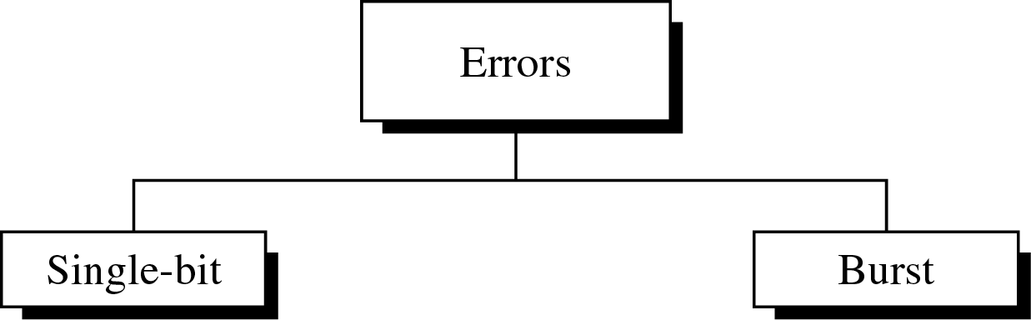
Type of Errors

Slide 6
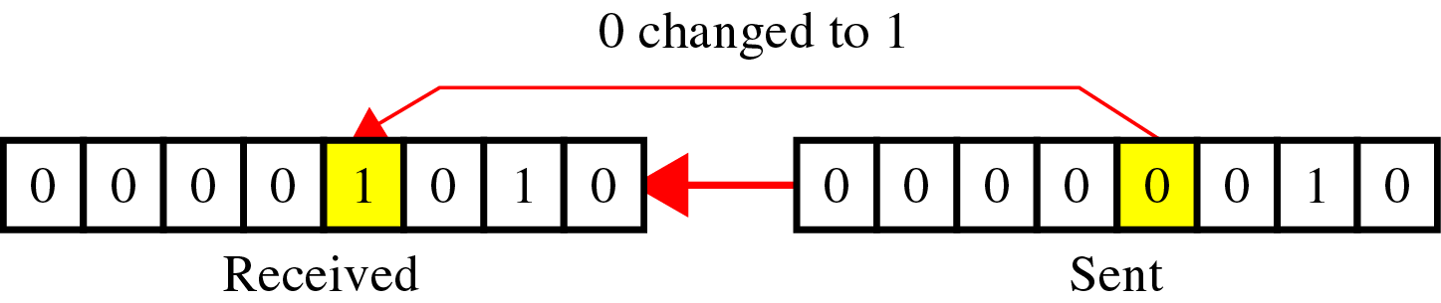
Type of Errors(cont’d)
Single-Bit Error
~ is when only one bit in the data unit has changed.

Slide 7
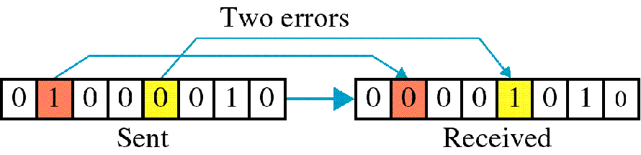
Type of Errors(cont’d)
Multiple-Bit Error
~ is when two or more nonconsecutive bits in the data unit have changed(ex : ASCII B - ASCII LF)

Slide 8
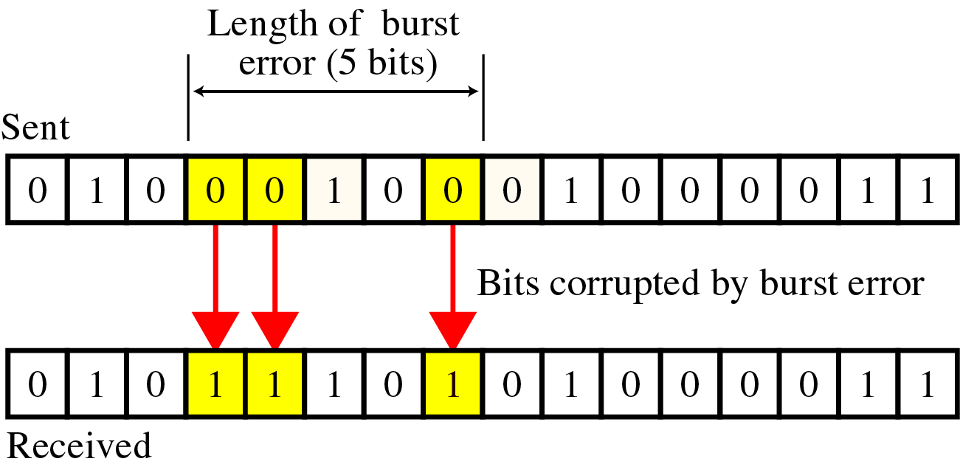
Type of Errors(cont’d)
Burst Error
~ means that 2 or more consecutive bits in the data unit have changed

Slide 9
Detection
Error detection uses the concept of redundancy, which means adding extra bits for detecting errors at the destination

Slide 10
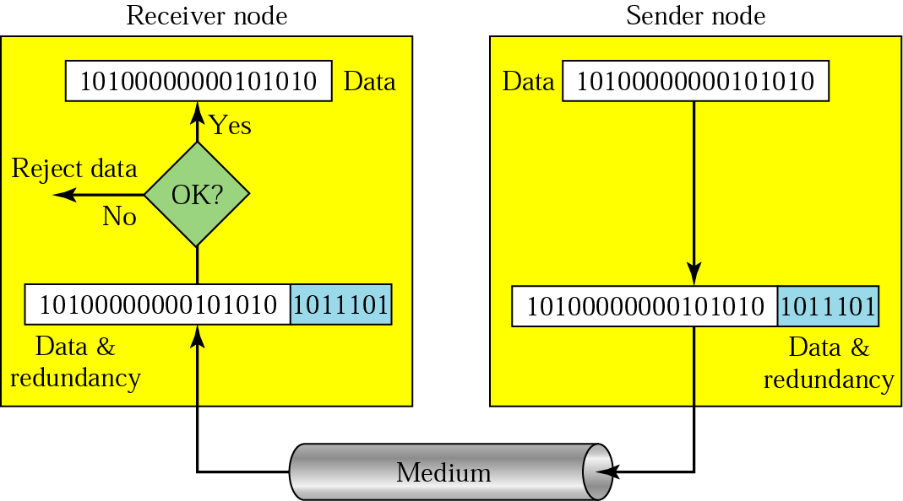
Detection(cont’d)
Redundancy

Slide 11
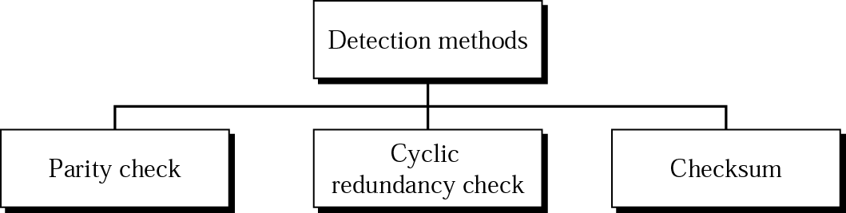
Detection(cont’d)
Detection methods

Slide 12
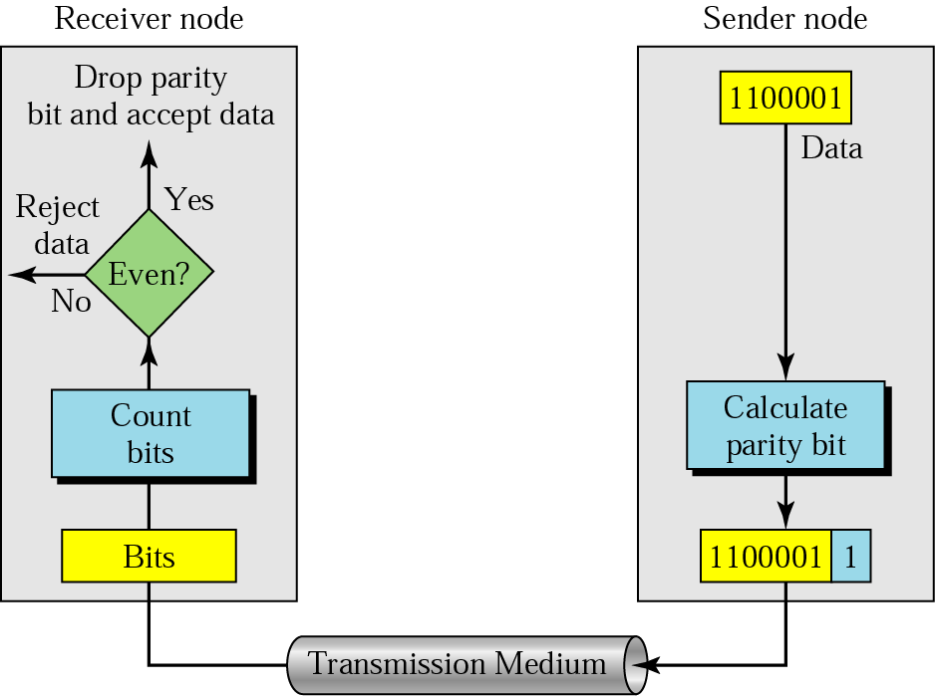
Detection(cont’d)
Parity Check
A parity bit is added to every data unit so that the total number of 1s(including the parity bit) becomes even for even-parity check or odd for odd-parity check
Simple parity check

Slide 13
Detection -examples
Example 1
Suppose the sender wants to send the word world.
In ASCII the five characters are coded as
1110111 1101111 1110010 1101100 1100100
The following shows the actual bits sent
11101110 11011110 11100100 11011000 11001001

Slide 14
Detection -examples
Example 2
Now suppose the word world in Example 1 is received by the receiver without being corrupted in transmission.
11101110 11011110 11100100 11011000 11001001
The receiver counts the 1s in each character and comes up with even numbers (6, 6, 4, 4, 4). The data are accepted.

Slide 15
Detection -examples
Example 3
Now suppose the word world in Example 1 is corrupted during transmission.
11111110 11011110 11101100 11011000 11001001
The receiver counts the 1s in each character and comes up with even and odd numbers (7, 6, 5, 4, 4). The receiver knows that the data are corrupted, discards them, and asks for retransmission.

Slide 16
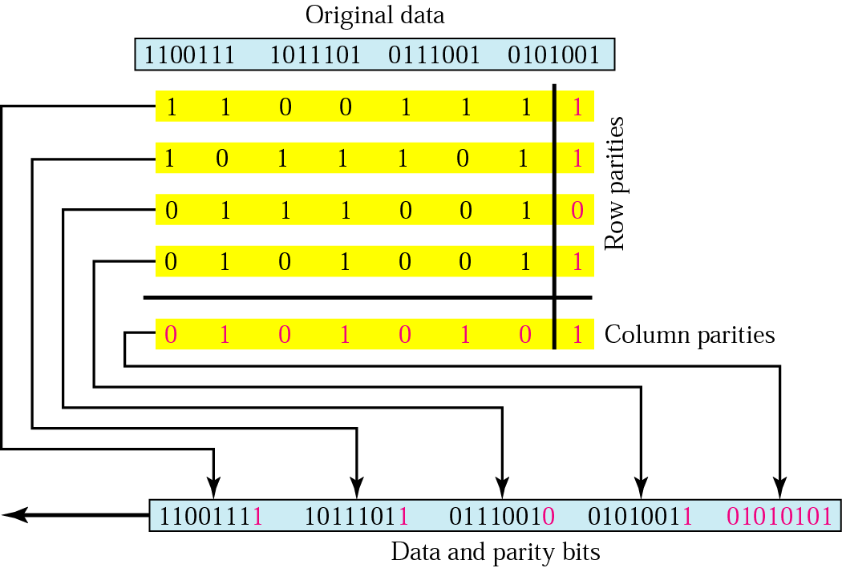
Two –Dimensional Parity Check

Slide 17
Detection - example
Example 4
Suppose the following block is sent:
10101001 00111001 11011101 11100111 10101010
However, it is hit by a burst noise of length 8, and some bits are corrupted.
10100011 10001001 11011101 11100111 10101010
When the receiver checks the parity bits, some of the bits do not follow the even-parity rule and the whole block is discarded.
10100011 10001001 11011101 11100111 10101010

Slide 18
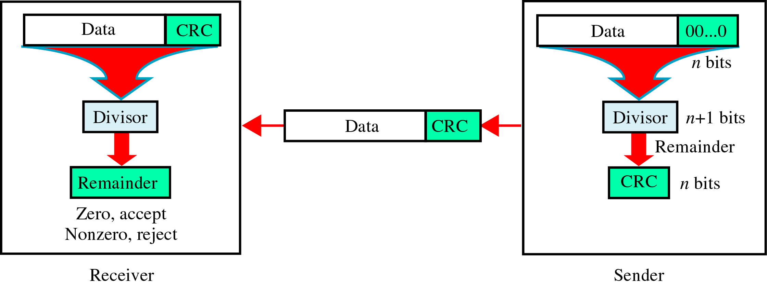
Detection(cont’d)
CRC(Cyclic Redundancy Check)
~ is based on binary division.

Slide 19
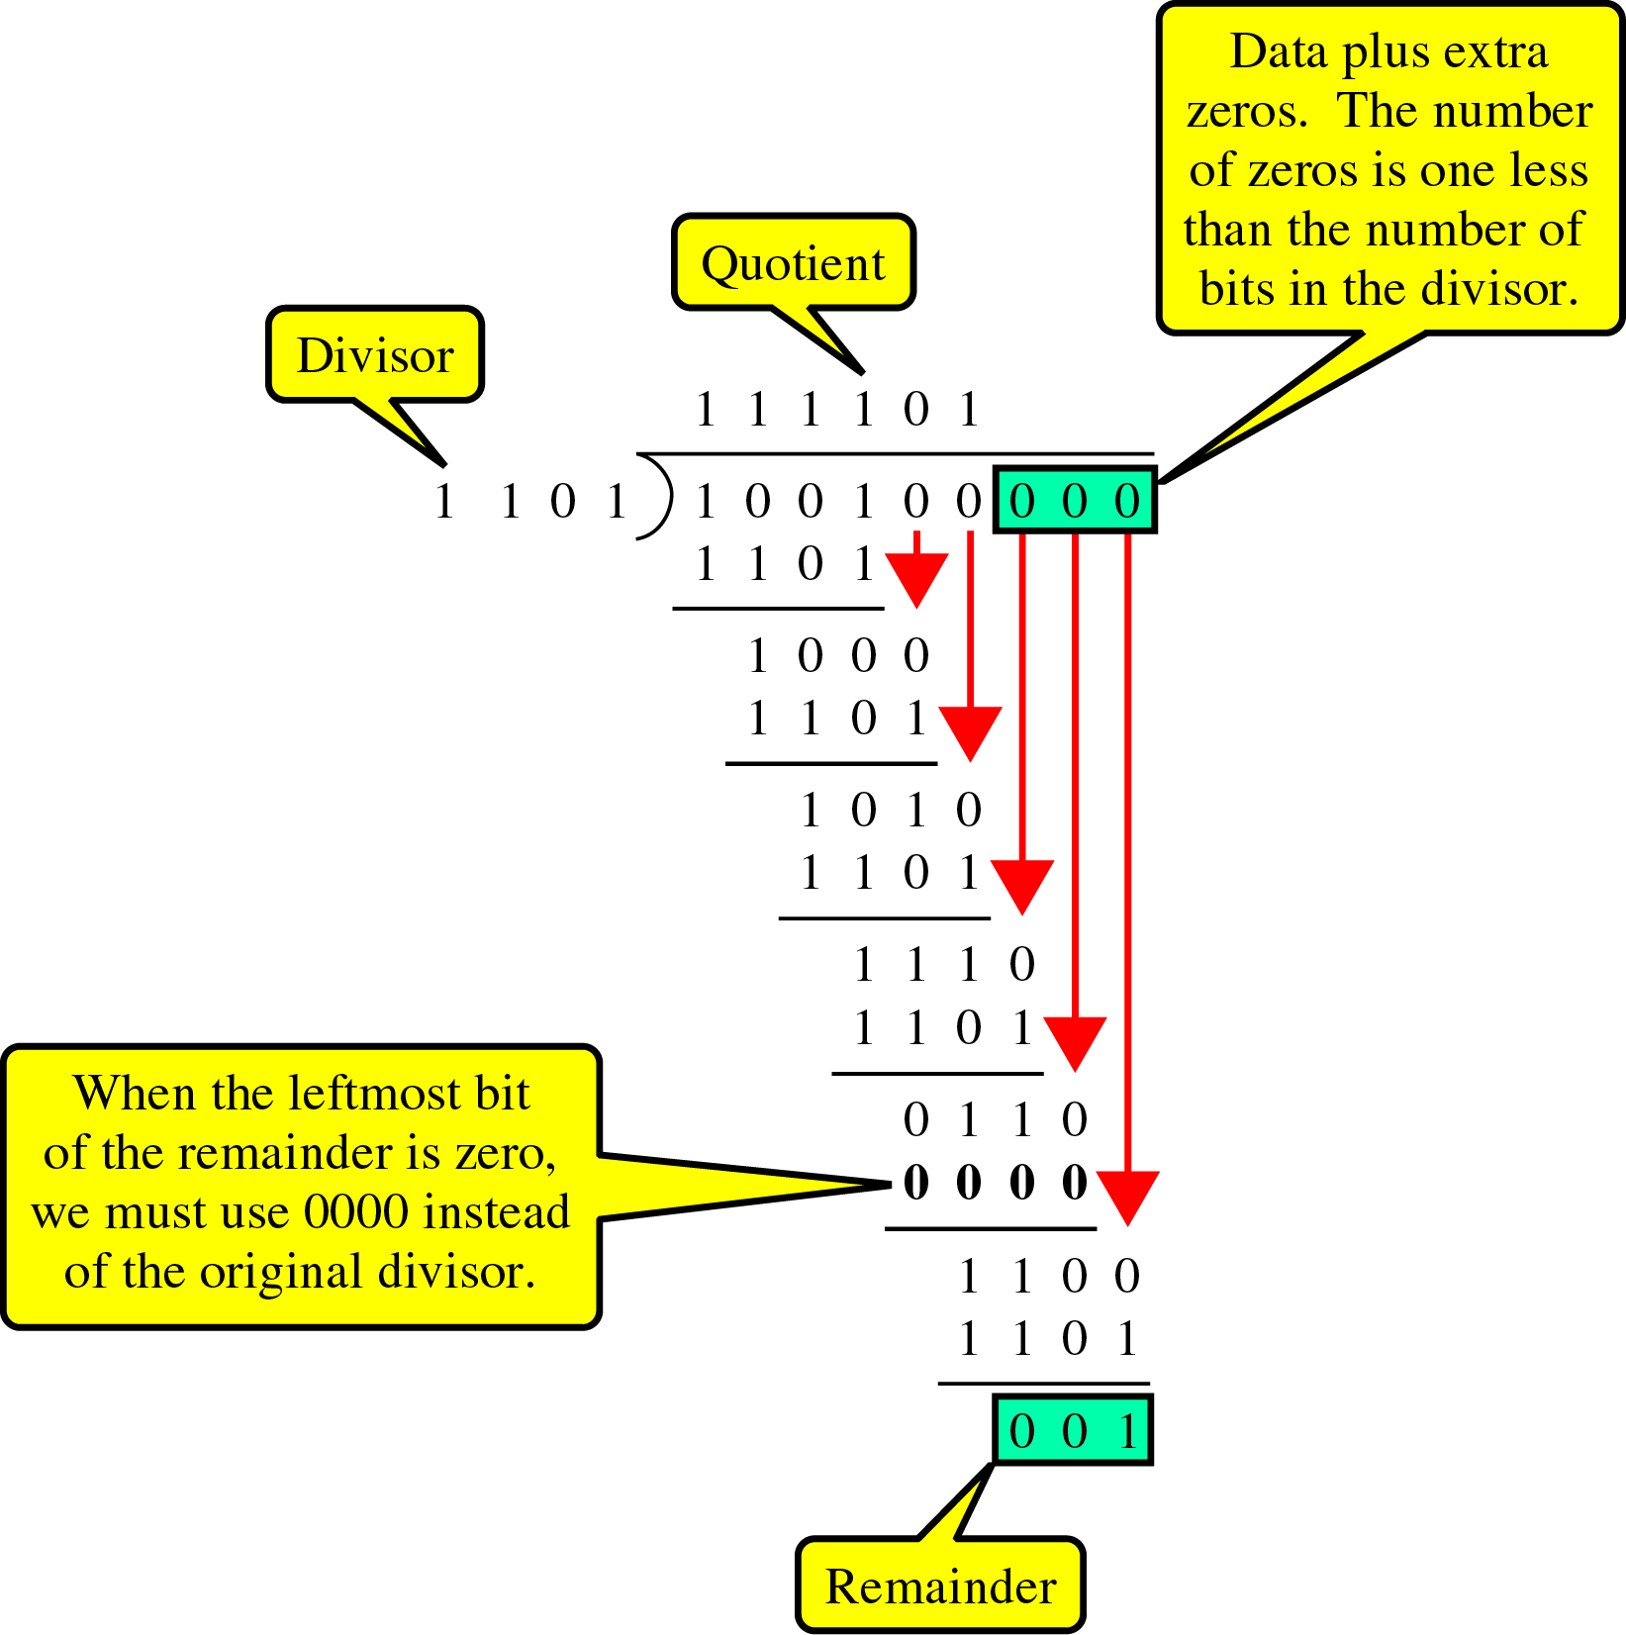
Detection(cont’d)
CRC generator
~ uses modular-2
division.
Binary Division
in a
CRC Generator

Slide 20
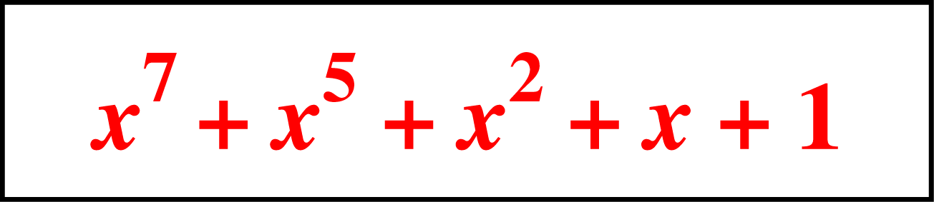
Detection(cont’d)
Polynomials
CRC generator(divisor) is most often represented not as a string of 1s and 0s, but as an algebraic polynomial.

Slide 21
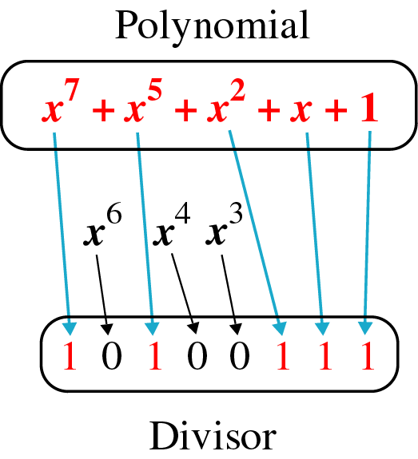
Detection(cont’d)
A polynomial representing a divisor

Slide 22
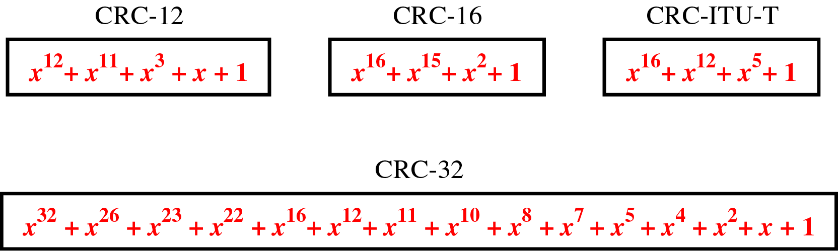
Detection(cont’d)
Standard polynomials

Slide 23
Detection(cont’d)
Checksum
~ used by the higher layer protocols
~ is based on the concept of redundancy(VRC, LRC, CRC ….)

Slide 24
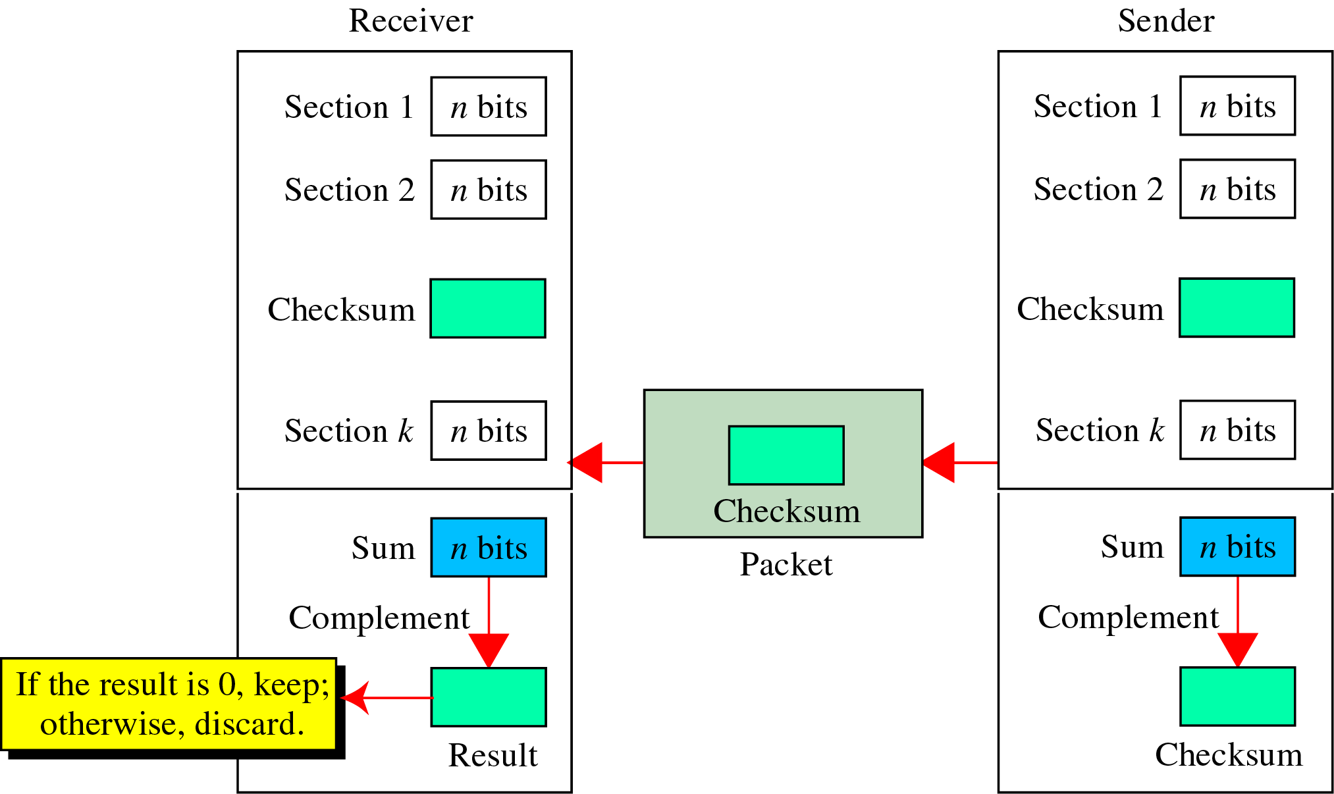
Detection(cont’d)
Checksum Generator

Slide 25
Detection(cont’d)
To create the checksum the sender does the following:
The unit is divided into K sections, each of n bits.
Section 1 and 2 are added together using one’s complement.
Section 3 is added to the result of the previous step.
Section 4 is added to the result of the previous step.
The process repeats until section k is added to the result of the previous step.
The final result is complemented to make the checksum.

Slide 26
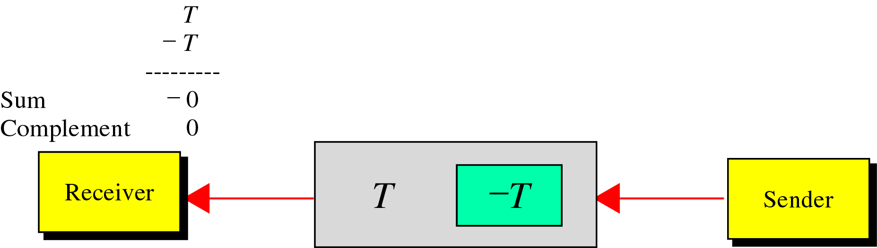
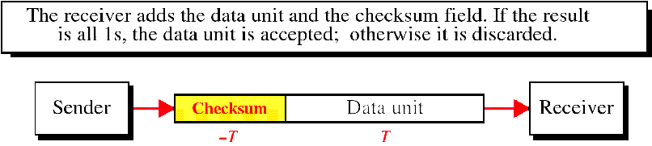
Detection(cont’d)
data unit and checksum

Slide 27
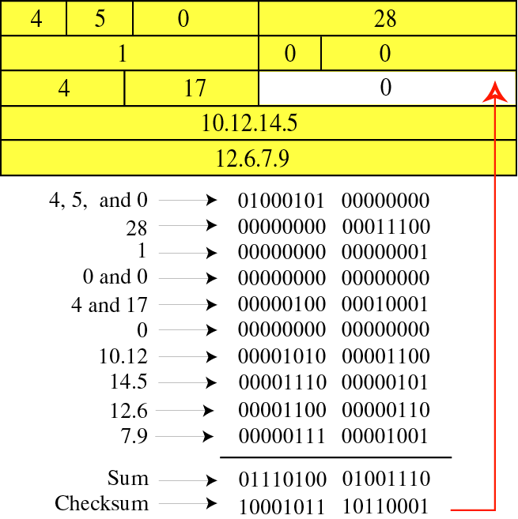
Detection(cont’d)

Slide 28
Detection(cont’d)
Example ( at a sender)
Original data : 10101001 00111001
10101001
00111001
--------------
11100010 Sum
00011101 Checksum
10101001 00111001 00011101

Slide 29
Detection(cont’d)
Example ( at a receiver)
Received data : 10101001 00111001 00011101
10101001
00111001
00011101
---------------
11111111 ← Sum
00000000 ← Complement

Slide 30
Error Correction
Error correction can be handled in two ways
when an error is discovered, the receiver can have the sender retransmit the entire data unit.
a receiver can use an error-correcting code, which automatically corrects certain errors.

Slide 31
Error Correction(cont’d)
Single-Bit Error Correction
parity bit
The secret of error correction is to locate the invalid bit or bits
For ASCII code, it needs a three-bit redundancy code(000-111)

Slide 32
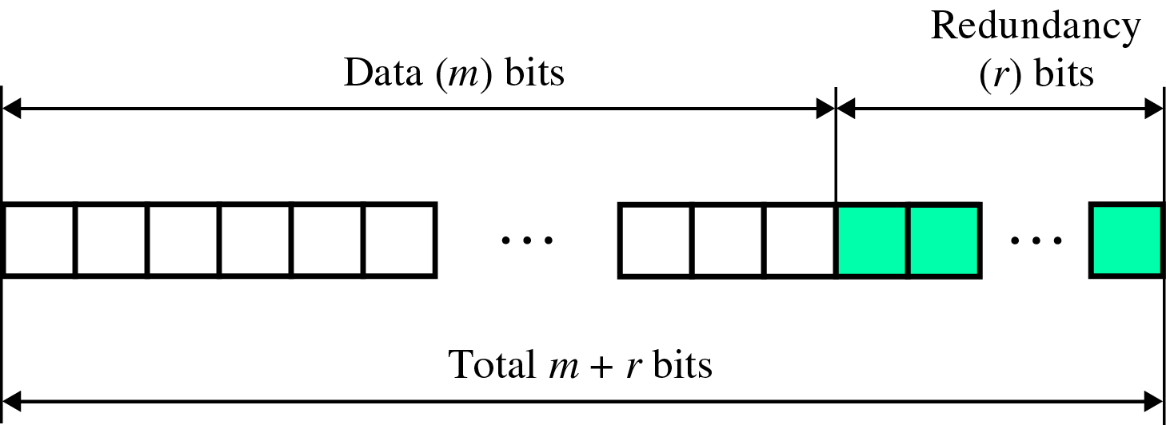
Error Correction(cont’d)
Redundancy Bits
~ to calculate the number of redundancy bits (R) required to correct a given number of data bit (M)

Slide 33
Error Correction(cont’d)
If the total number of bits in a transmittable unit is m+r, then r must be able to indicate at least m+r+1 different states
2^{r} ≥ m + r + 1
ex) For value of m is 7(ASCII), the smallest r value that can satisfy this equation is 4
2⁴ ≥ 7 + 4 + 1

Slide 34
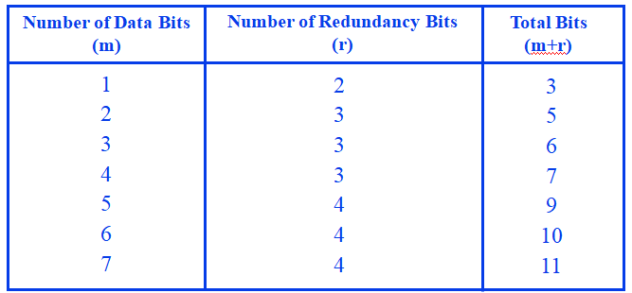
Error Correction(cont’d) Relationship between data and redundancy bits

Slide 35
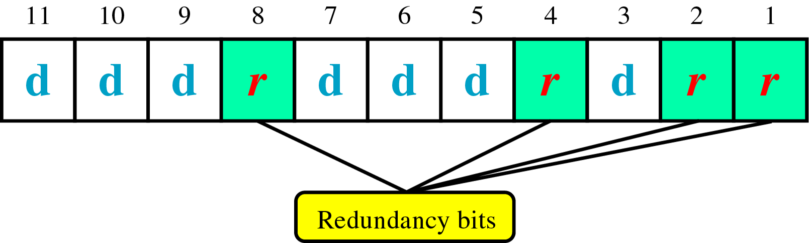
Error Correction(cont’d)
Hamming Code
~ developed by R.W.Hamming
positions of redundancy bits in Hamming code

Slide 36
Error Correction(cont’d)
each r bit is the VRC bit for one combination of data bits
r₁ = bits 1, 3, 5, 7, 9, 11
r₂ = bits 2, 3, 6, 7, 10, 11
r₄ = bits 4, 5, 6, 7
r₈ = bits 8, 9, 10, 11

Slide 37
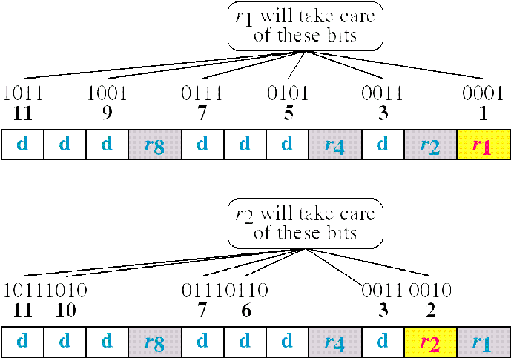
Error Correction(cont’d) Redundancy bits calculation(cont’d)

Slide 38
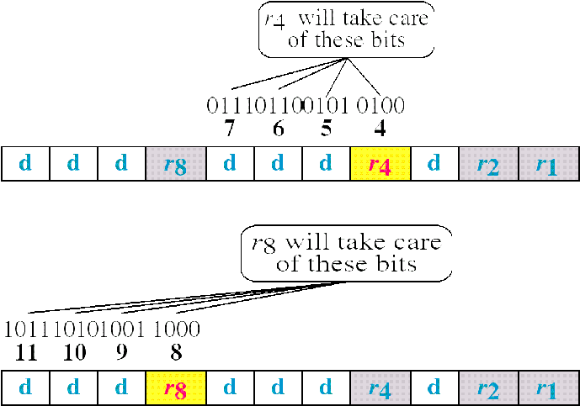
Error Correction(cont’d) Redundancy bits calculation(cont’d)

Slide 39
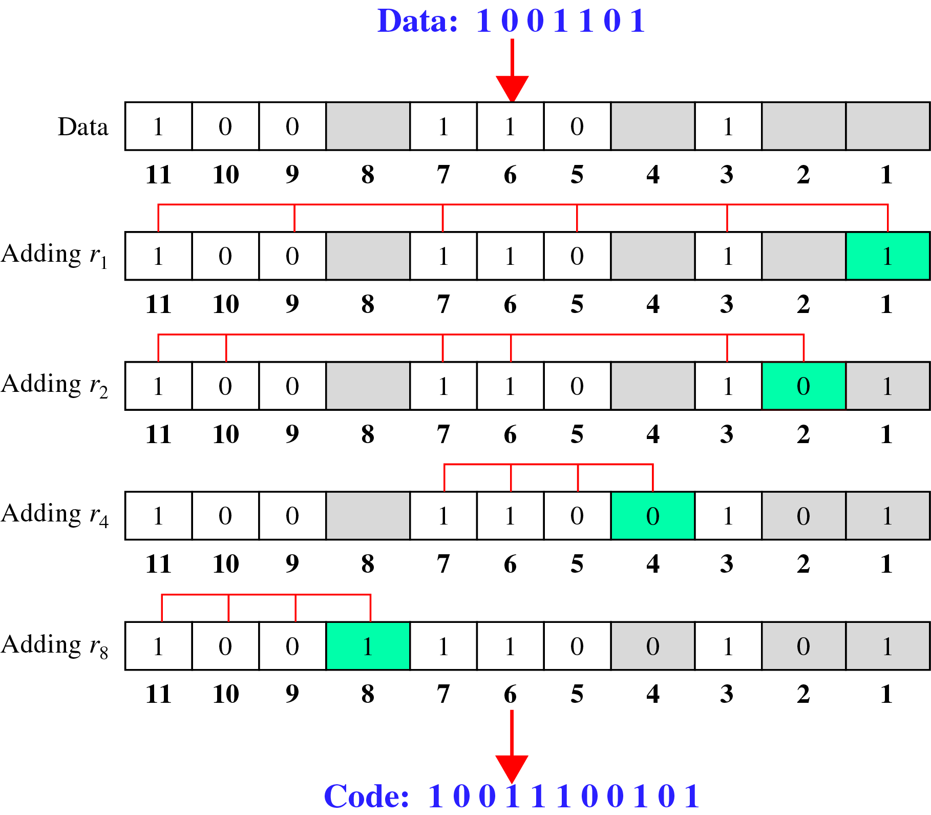
Error Correction(cont’d) Calculating the r values

Slide 40
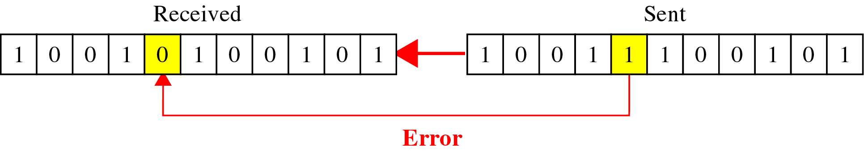
Error Correction(cont’d) Error Detection and Correction

Slide 41
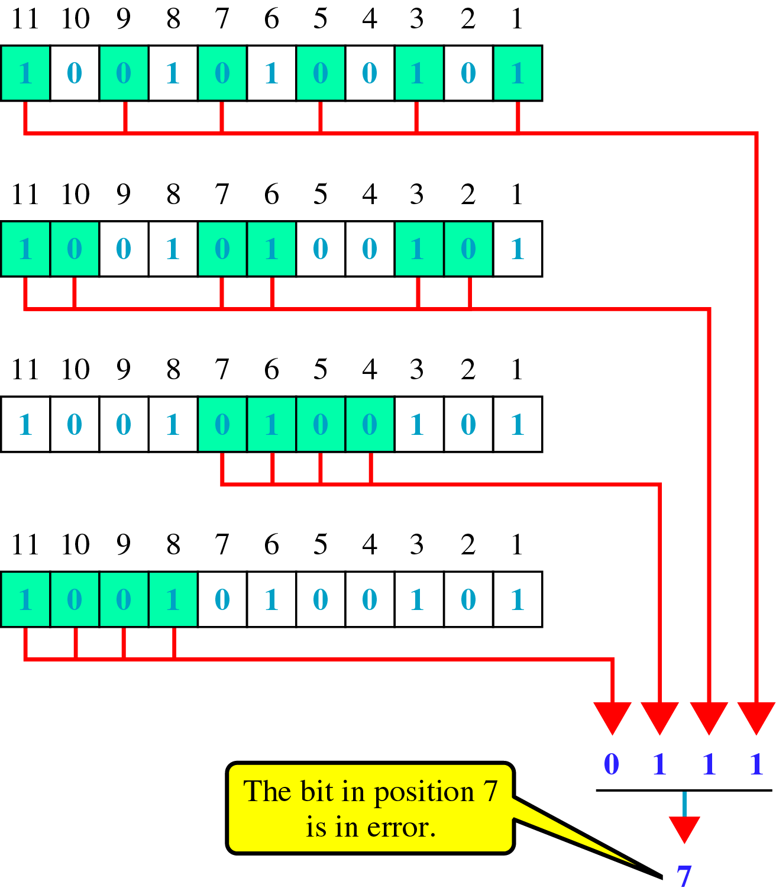
Error Correction(cont’d)
Error detection using Hamming Code

Slide 42
Error Correction(cont’d)
Multiple-Bit Error Correction
redundancy bits calculated on overlapping sets of data units can also be used to correct multiple-bit errors.
Ex) to correct double-bit errors, we must take into consideration that two bits can be a combination of any two bits in the entire sequence

